Slide 1
V
IGNITE

Slide 2

Our Team
Sanidhya Meshram
Third Year IT,
GECA
Falguni Ajmera
Third Year IT,
GECA
Tanay Bhatt
Third Year ENTC,
GECA
Shreyas Chele
Third Year IT,
GECA

Slide 3

GreenEx.com
Reduce Carbon Footprint

Slide 4
Problem Statement
Rising awareness of climate change brings the attention of governments to solve this issue in the immediate. So, developed countries need a way to leverage their resources in order to reduce the carbon footprint on earth. Developing countries opening up to the idea of industrialization can adopt green sustainable measures in order to earn CER’s from the authorities.

Slide 5
Introduction
Carbon Dioxide (CO2) the most important greenhouse gas produced by combustion of fuels has become a cause of global panic as its concentration in the earth’s atmosphere has been rising alarmingly.
This devil however, is now turning in to a product that helps people, countries, consultants, traders, corporations and even farmers earn billion of rupees. This was an unimaginable trading opportunity not more than a decade ago.

Slide 6
What is Carbon Trading?
Carbon trading is a advances format, where firms or countries buy and sell carbon permits as part of a program to trim out carbon emission. It is a widespread method countries utilize in order to meet their obligations specified by international Kyoto Protocol (1997) of United Nations Framework Convention on Climate Change; namely the reduction of carbon emissions in order to mitigate future climate changes. It specifically targets carbon dioxide calculated in terms of CO2 equivalent or CO2.
The need for carbon trading was felt when it was realized that the industries have been the biggest polluter of green house gases which has resulted in global warming. It was realized that the only way to get the attention of the world towards these problems was by attaching some financial incentive to it. As a result the concept of Carbon trading was introduced.

Slide 7
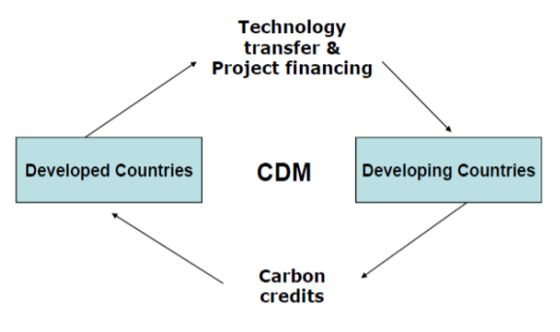
What is Clean Development Mechanism (CDM)?
Under the CDM one can cut the deal for carbon credit. Under the UNFCCC, charter any company from the developed world can tie up with a company in the developing country that is a signatory to the Kyoto Protocol.
These companies in developing countries must adopt newer technologies, emitting lesser gases, and save energy.

Slide 8
Process of Carbon Trade
The process or mechanism of Carbon credit was formalized in the Kyoto Protocol, an international agreement between more than 170 countries. The stages of this mechanism includes -
Assigned Amounts (AA):
Under the Kyoto Protocol, the 'caps' or quotas for Greenhouse gases for the developed Annex 1 countries are known as Assigned Amounts and are listed in Annex B.
Assigned Amount Units (AAUS):
The quantity of the initial assigned amount is denominated in individual units, called Assigned amount units (AAUs), each of which represents an allowance to emit one metric tonne of carbon dioxide equivalent, and these are entered into the country's national registry.
Operators:
In turn, these countries set quotas on the emissions of installations run by local business and other organizations, generically termed 'operators'.
Clearing House (Trade):
Each operator has an allowance of credits, where each unit gives the owner the right to emit one metric tonne of carbon dioxide or other equivalent greenhouse gas. Operators that have not used up their quotas can sell their unused allowances as carbon credits, while businesses that are about to exceed their quotas can buy the extra allowances as credits, privately or on the open market.

Slide 9
Indian Scenario
India signed and ratified the Protocol in August, 2002 and has emerged as a world leader in reduction of greenhouse gases by adopting CDMs in the past few years.
India stands with the second largest portfolio of carbon contracts with a market share of 16 percent, behind China having a 62 percent market share.
Carbon, like any other commodity, is being traded on India's Multi Commodity Exchange.
Global trading in carbon credits trading was estimated at $5 billion in 2011, with India contributing around $1 billion (Birla et. al, 2012).
The registered CDM projects and NCDMA approved projects from India exhibit an investment of more than INR 1.6 trillion and INR 5.5 trillion respectively (GIZ, 2014).
India and China are likely to emerge as the biggest sellers of carbon credits.

Slide 10
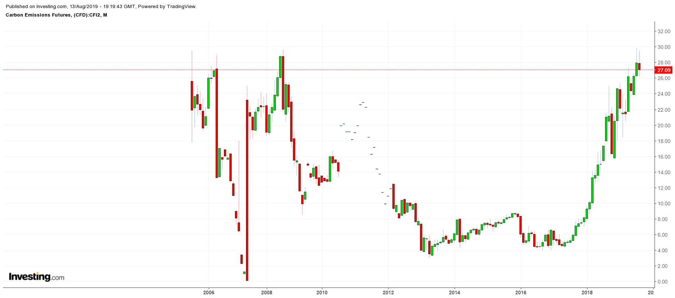
Market Trends – Carbon Credit Prices (2005-2019)
↑€
19

Slide 11
What does the green spike in the graph signify?
Around 2008, the price of carbon had been far too low, because an economic slowdown starting in 2008 meant that far too many free allowances were being given out. As governments, companies, and individuals the world over are increasingly seeking to address their contributions to global warming, the use of voluntary carbon markets is starting to accelerate after several years of slow growth.
There are two primary reasons why the increased volume of trading on voluntary carbon markets last year could be just the beginning of a longer growth trend. The first is that several countries, in seeking to meet their commitments under the Paris Climate Agreement, are starting to use voluntary carbon offsets as a means of accelerating the pace of de-carbonization within their economies.
The second reason is that airlines could begin using voluntary offsets, as well, in order to meet the global cap on airline emissions set by the Carbon Offsetting and Reduction Scheme for International Aviation (CORSIA). The Paris Agreement and CORSIA create what are known as compliance markets, which is when government regulators require greenhouse gas emitters to either reduce or offset their emissions, as opposed to those entities doing so voluntarily.
EU legislators have enacted a number of reforms to the system over the past four years in order to fix this problem. These included the establishment of a market stability reserve to remove carbon credits of 1.7 billion tons from the market. From January 2019 a Market Stability Reserve (MSR) is cancelling 24% of the surplus each year up to 2023 and 12% thereafter.

Slide 12
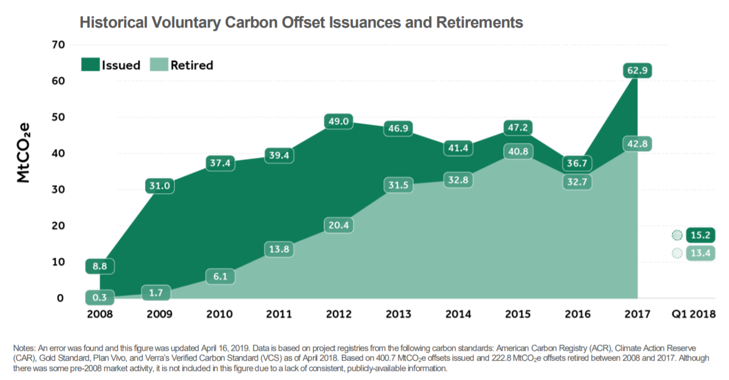
Market Trends - Total supply and demand of carbon offsets

Slide 13
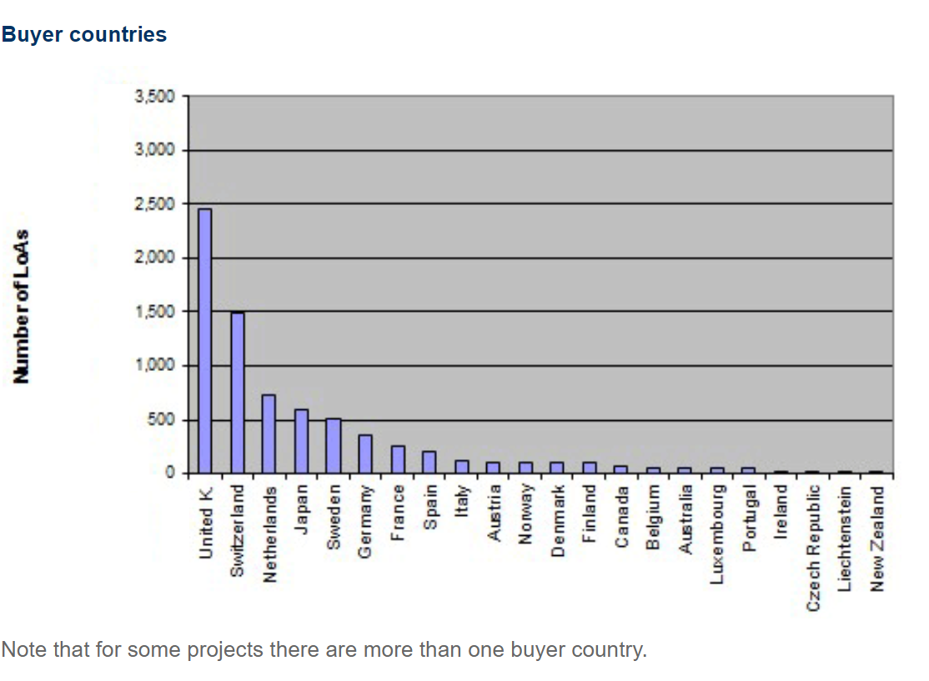
Market Trends – Major buyers of carbon credits

Slide 14
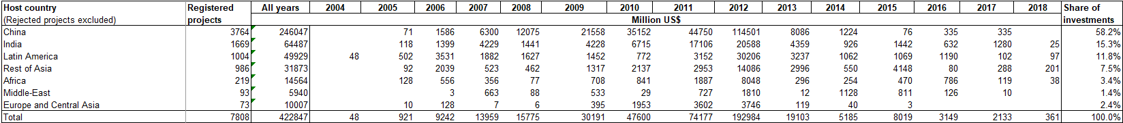
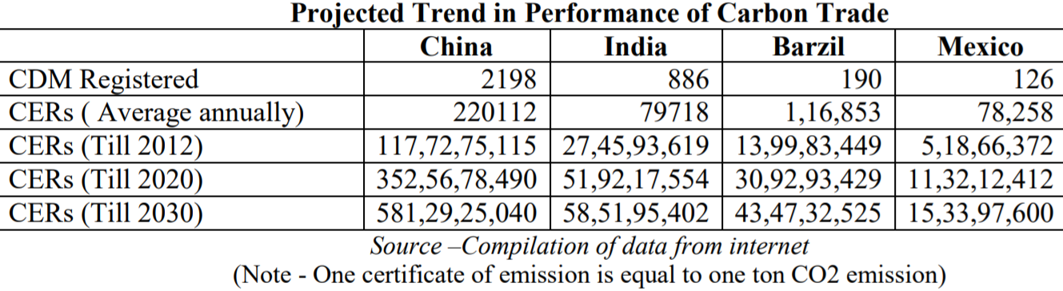
Market Trends – Performance Projections
Market Trends – Investments through CDM (2004-2018)

Slide 15
Our Solution
We seek to develop an e-commerce website allowing buyers and sellers to trade cash for carbon credits.
Features of the website –
Brings market access to global carbon markets
Trade in foreign currencies
Up-to-date market information
Offers connections to auditing authorities
Connections to renewable tech companies, NGOs etc.

Slide 16
Business Model
Account creation for companies registered under the United Nations CDM.
Banking Interface
Revenue earning model : Commission
Cybersecurity
Scalable to meet future demands

Slide 17
Business Projections
Year | Estimated Number Of CERs in Demand* | Estimated Average Price Of 1 CER (in €)** | Estimated Total Amount Of Transactions (in €)***
2020 | 50,000,000 | 27.54 | 1,377,000,000
2022 | 55,000,000 | 28 | 1,540,000,000
*Assuming there is a 5% rise in number of CERs in demand every year
**Assuming there is a 2% rise in the market price of CER every year
***Assuming total amount of carbon trade transactions = Number of CERs in a year x Average price of a CER in that year
Looking at the figures mentioned in the above table, we wish to join the set of already existing market players. The market is set to grow and the opportunities seem to be favourable for our trade.

Slide 18
Roadmap until hackathon…
Aug 15th-20th
21st- 31st
Sept 1st-13th
14th-15th
Market Analysis
Content Strategy
Research Competitors
Legal Aspects
Frontend UI
Branding
Styling & Design
Content Review
Build Prototype
Online Transactions
Database Management
Business Logic
Hack Time!
Build
Amend
Deploy
Present
Notes:
© Copyright PresentationGO.com – The free PowerPoint and Google Slides template library

Slide 19
Summary
Carbon-emission credits are now one of the world’s best-performing investments.
The price of the credits, doled out by governments to polluting power plants and mills to curtail the production of greenhouse gases, has soared more than fivefold over the past two years.
Thus we see that Carbon Trading is definitely the “Greenest” pastures for business trading for the small and large scale private and governmental sectors in India with opportunities for everyone.
We intend to put forward the technologies and market standards that we can set so that the concept of carbon trading can have its roots in India too.

Slide 20
Thank You

